Slide 1

"Flushing-Main Street: Asian Cultural Hub & Transit-Rich Rental Market Analysis
subway_map:7:Flushing-Main Street

Slide 2

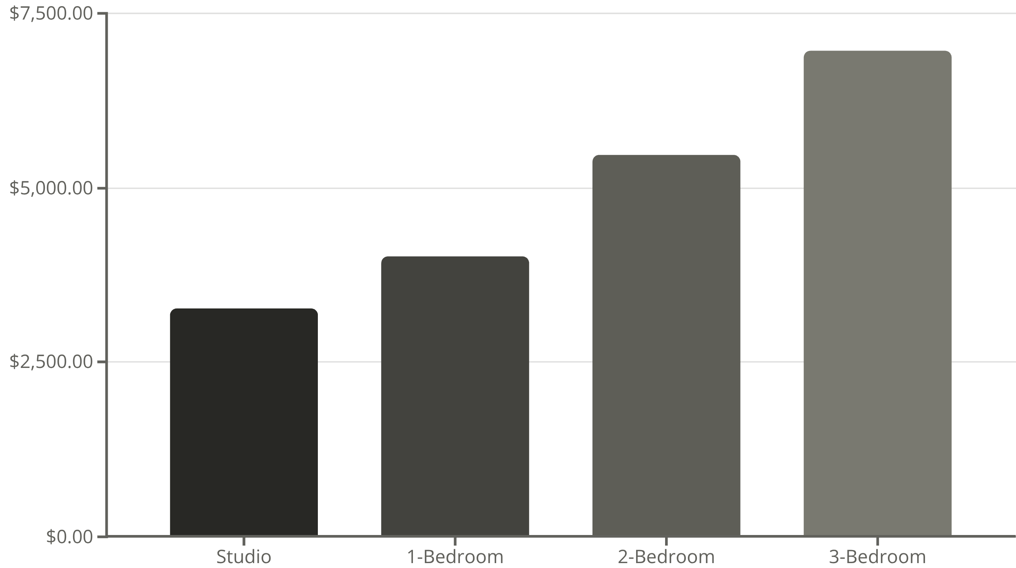
Average Monthly Rent by Apartment Size
Not specified - typical range for area is $1,600-$3,000+ depending on unit size
Direct commute to Times Square-42nd Street on 7 line, approximately 30 minutes, with express train options during rush hours and 24/7 service availability
Year-over-year increase
Above national average
Living near Flushing-Main Street station puts you at the heart of New York City's largest and most vibrant Asian community. The neighborhood offers an immersive cultural experience with countless authentic restaurants, bustling food courts, and specialty markets like H Mart and J-Mart. Street-level energy is constant, with vendors selling everything from fresh produce to bubble tea. The 7 train provides convenient access to Manhattan, while the area's cultural authenticity and amenities make it feel like a city within a city. Housing options range from modern luxury developments to more affordable walk-ups, catering to various budgets and preferences in this dynamic Queens community.

